Slide 1

14 Algoritma Shortest Path
TI0073 – Algoritma dan Pemrograman

Slide 2
Agenda
Algoritma Shortest Path
Dijkstra
Travel Salesman Problem

Slide 3
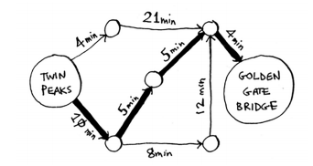
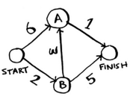
Shortest Path
Jarak terpendek adalah bagaimana mencari sebuah jalur pada suatu jalur kompleks yang meminimalkan jumlah bobot sisi pembentuk jalur tersebut

Slide 4
Berbagai Algoritma Shortest Path
Algoritma Bellman-Ford
Algoritma Dijkstra (untuk weighted graph)
Algoritma Floyd-Warshall
Algoritma pencarian A*
Algoritma Johnson
Algoritma Viterbi
Aplikasi banyak ditemukan pada rute peta (Google Maps, dll)

Slide 5
Algoritma Shortest Path
Find the “cheapest” node. This is the node you can get to in the least amount of time.
Update the costs of the neighbours of this node
Repeat until you’ve done this for every node in the graph.
Calculate the final path.

Slide 6
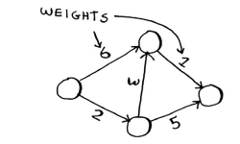
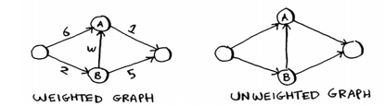
Terminologi - weighted
Each edge in the graph has a number associated with it. These are called weights
A graph with weights is called a weighted graph. A graph without weights is called an unweighted graph.

Slide 7
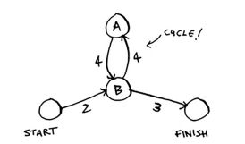
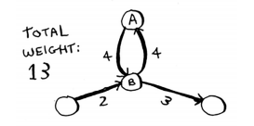
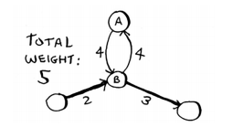
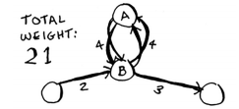
Terminologi (2) - cycle
cycle
Follow cycle
Follow cycle twice
Avoid cycle

Slide 8
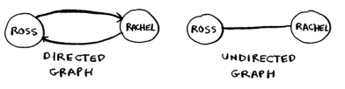

Terminologi (3) – directed/undirected
An undirected graph means that both nodes point to each other. That’s a cycle!

Slide 9
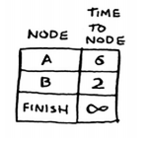
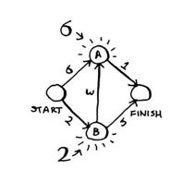
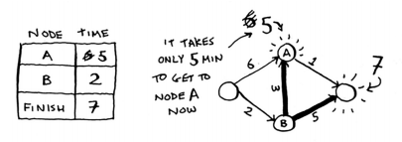
Langkah 1 dan 2
1
2

Slide 10
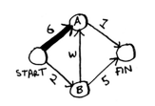
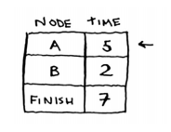
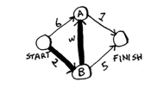
Recap
1
2

Slide 11

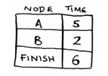
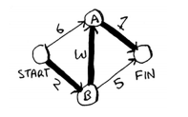
Langkah 3 dan 4
Finally

Slide 12
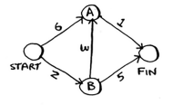
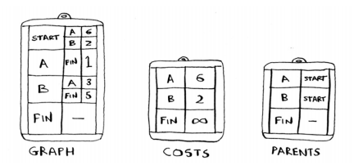
Implementasi

Slide 13
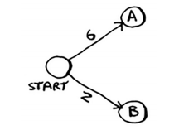
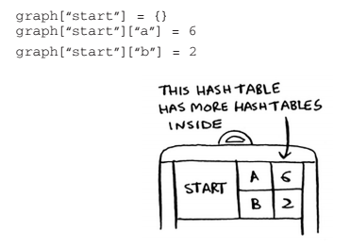
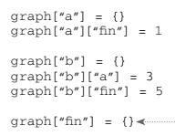
Implementasi
Pengisian data
Pengisian data

Slide 14
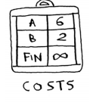

Implementasi

Slide 15
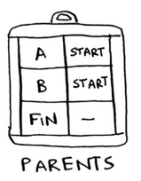

Implementasi

Slide 16
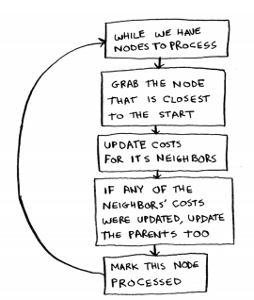
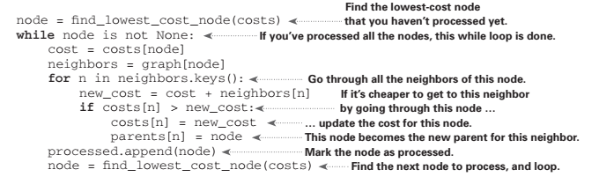
Algoritma Djikstra

Slide 17
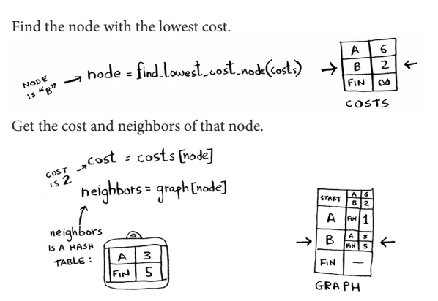
Detail implementation

Slide 18
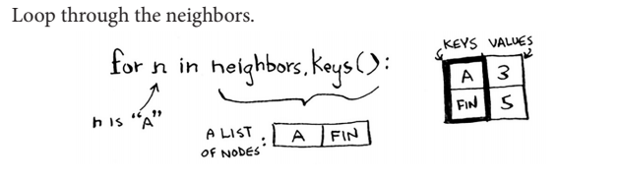
Detail implementation

Slide 19
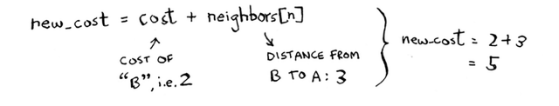
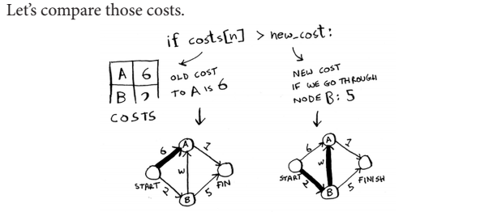
Detail implementation

Slide 20
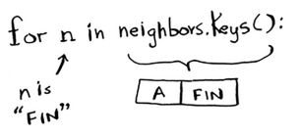
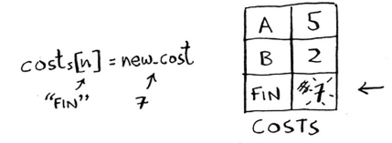
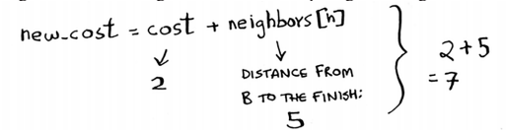
Detail implementation

Slide 21
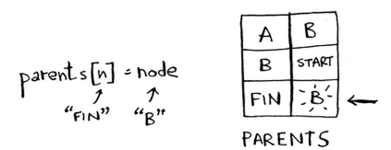

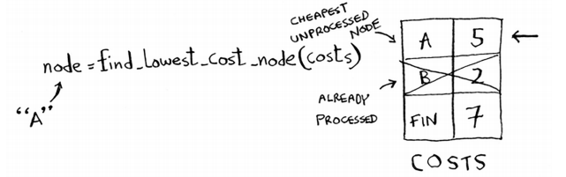
Detail implementation

Slide 22
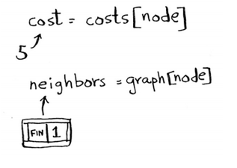
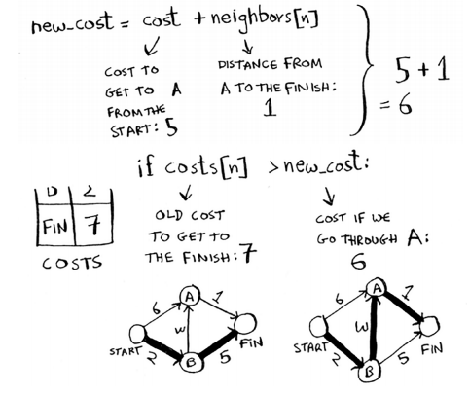
Detail implementation

Slide 23
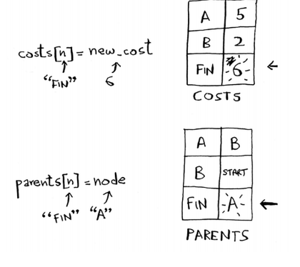
Detail implementation

Slide 24
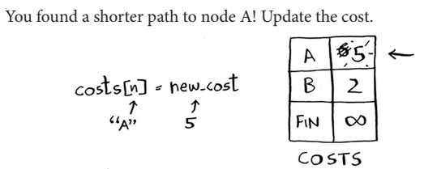
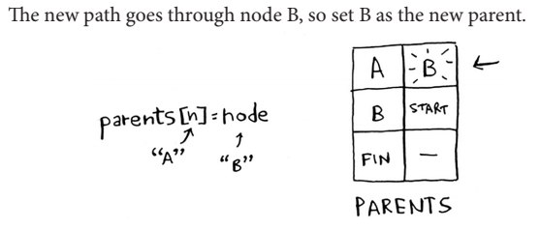
Detail implementation

Slide 25
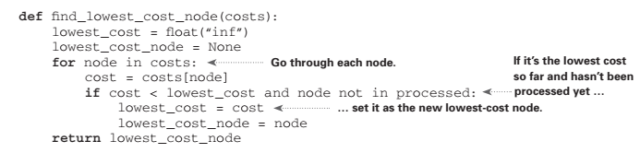
Fungsi find_lowest_cost_node

Slide 26


Slide 27
Minggu Depan 15 – Analisis Algoritma

